Slide 1
CMPE 273 - Lecture 1
Distributed Systems Overview

Slide 2
What is Distributed System?
A collection of independent computers connected via a network that appears to its users as a single coherent system.单相干系统
A software that runs in a distributed system is called a distributed software system.
A problem is divided into many tasks, each of which is solved by one or more computers.
Notes:
Zoom : UDP

Slide 3
Characteristics of Centralized Systems
非自治
Single machine with non-autonomous software component
All resources accessible from one place
Software runs in a single process
Single Point of control
Single Point of failure
Reliable Performance
Secure

Slide 4
Characteristics of Distributed Systems
Multiple machines with multiple autonomous components
Resources may not be accessible from one place
Software runs in concurrent processes on different processers.
Multiple Point of control
Multiple Point of failure
Fault-Tolerant
Highly Available
Scalable and secure
Predictable Performance
同时
Notes:
Scalable可扩展的： you can handle so many sessions happening online at the same time

Slide 5
Examples of Distributed Systems
Interbank networks
Peer-to-peers (P2P) Systems
Internet and World Wide Web
Social network
Real-time distributed systems
Sensors networks
Grid, Edge, and cloud computing
Notes:
Interbank networks： how bank to bank talk to each other
P2p: share data in real time
没讲：
Internet and World Wide Web
Social network
Real-time distributed systems
Sensors networks
Grid, Edge, and cloud computing

Slide 6
Eight Fallacies of Distributed Computing
Notes:
Fallacies: 谬论

Slide 7
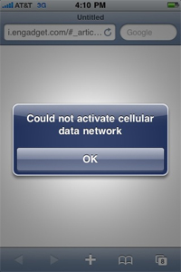
1. The network is reliable.
Our systems are spanned across multiple processes and nodes.
They require network to communicate with each other.
Notes:
Spanned 跨度

Slide 8
What is latency?
Latency is the amount of time that a request takes for some data to travel from one point to another.
Notes:
Latency延迟
How to measure latency from my machine to any server:
open terminal
su@SUs-MacBook-Pro ~ % ping www.google.com
PING www.google.com (216.58.194.196): 56 data bytes
64 bytes from 216.58.194.196: icmp_seq=0 ttl=116 time=8.861 ms
64 bytes from 216.58.194.196: icmp_seq=1 ttl=116 time=8.672 ms
64 bytes from 216.58.194.196: icmp_seq=2 ttl=116 time=8.762 ms
64 bytes from 216.58.194.196: icmp_seq=3 ttl=116 time=8.658 ms
64 bytes from 216.58.194.196: icmp_seq=4 ttl=116 time=8.861 ms
64 bytes from 216.58.194.196: icmp_seq=5 ttl=116 time=27.918 ms
10 packets transmitted, 10 packets received, 0.0% packet loss
round-trip min/avg/max/stddev = 8.363/10.233/23.628/4.477 ms

Slide 9
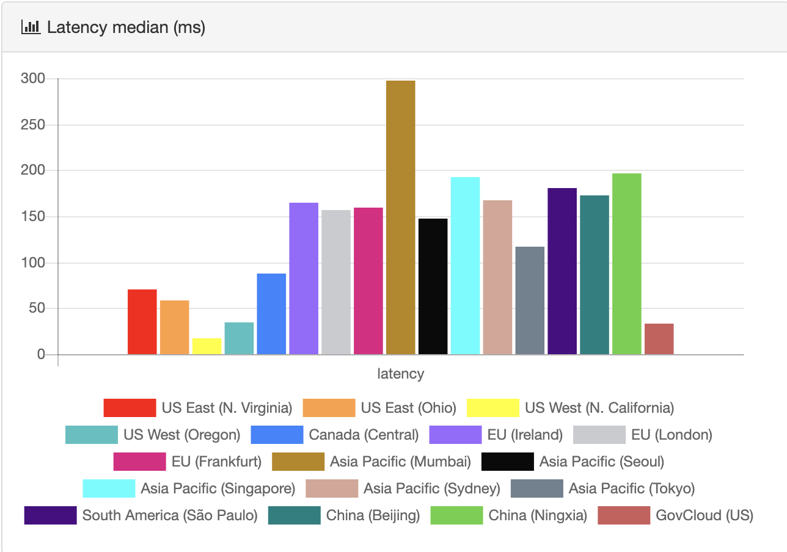
2. Latency is zero.
Amazon Web Services Latency per Region
https://ping.psa.fun/

Slide 10
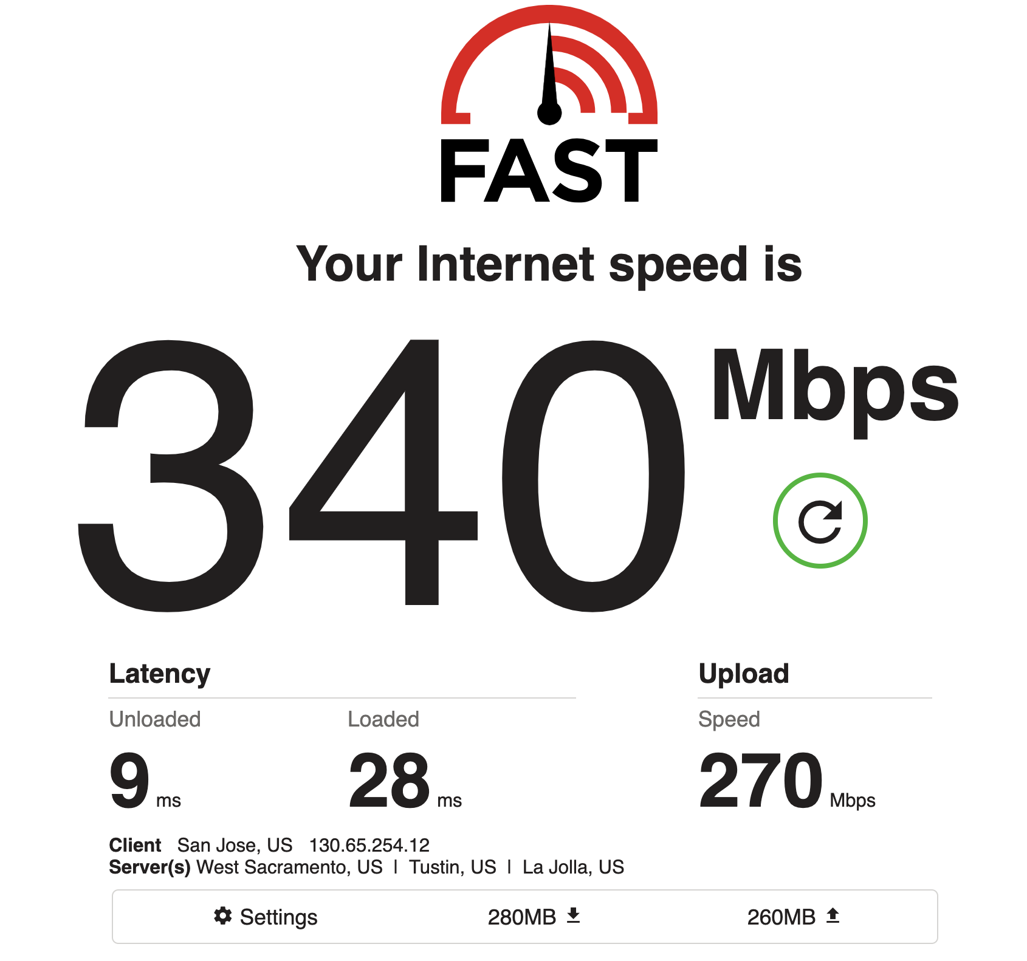
3. Bandwidth is infinite.
Bandwidth is the capacity of a network to pass data through.
https://fast.com
Notes:
How wide it is from one node to another

Slide 11
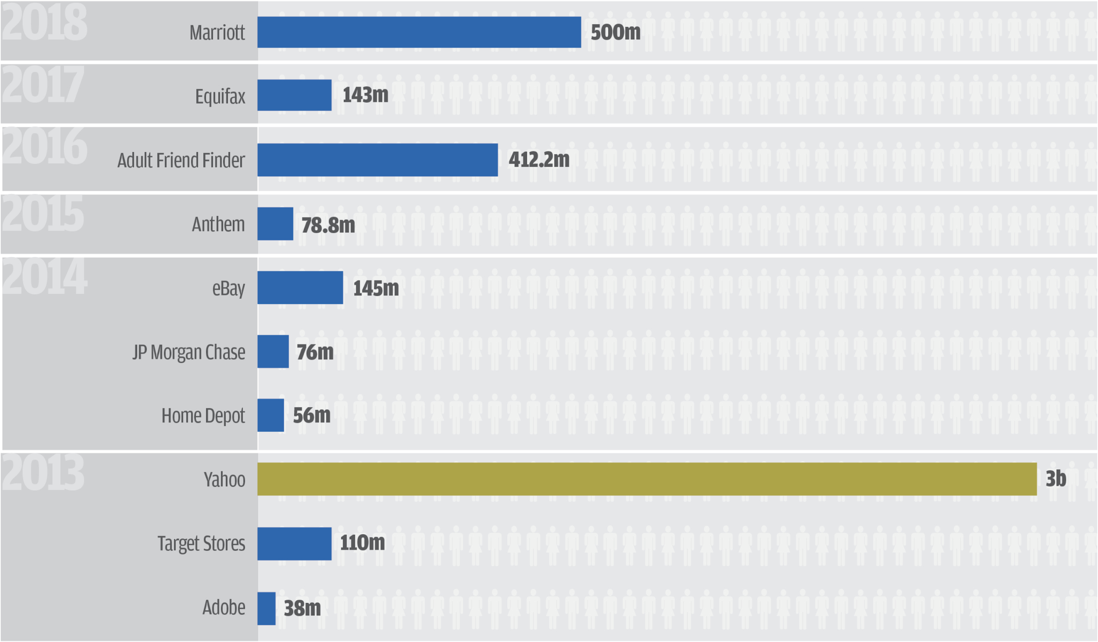
4. Network is secure.
Biggest data breaches of the 21st century

Slide 12
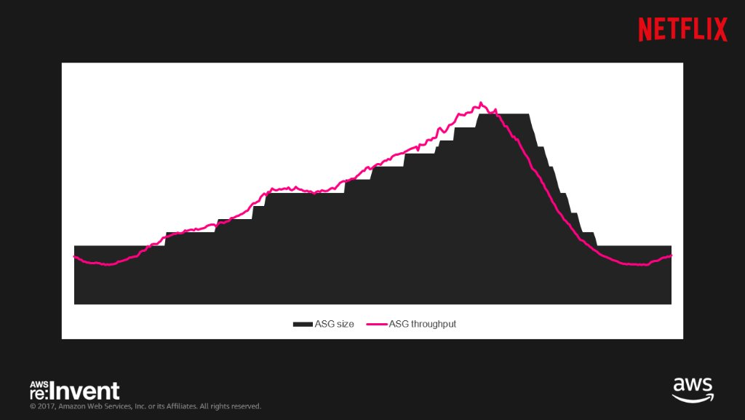
5. Topology does not change.
Auto-Scaling Group based on throughput at Netflix
Flat line
Notes:
TOPOLOGY: (拓扑学) How you describe your physical networks, it described your architecture.
Black boxes are the actual number of ec2 instances in that particular time window
Ec2 is 亚马逊弹性云计算，是由亚马逊公司提供的Web服务，是一个让用户可以租用云端电脑运行所需应用的系统。
The number of server was bound to the auto scaling groups are proportionally added and adjusted depending on the throughput
Flat line: lies a little longer because they waited for send tie hit the threshold闸，becoz they want to fully utilize resources
Decrease part: auto scaling group is slower because ec2 takes 30 to 40 minutes , depending on how complex it is .

Slide 13
6. There is one administrator.
Notes:
Segment 分割 called vpc(virtual private clouds)

Slide 14
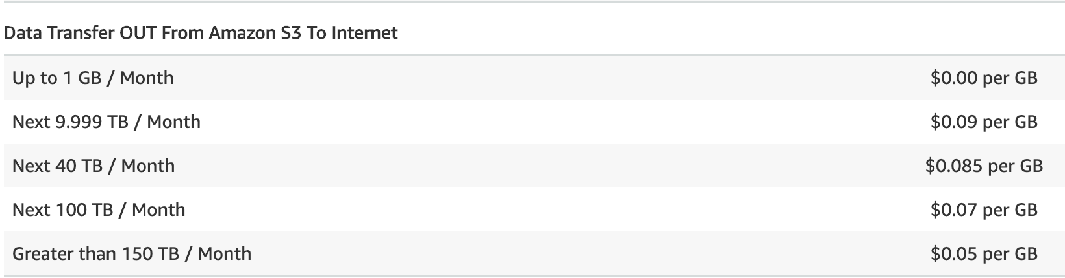
7. Transport cost is zero.
Amazon Web Services S3 Data Transfer Pricing

Slide 15
7. Transport cost is zero.
Network infrastructure cost 网络基础设施成本
Serialization/deserialization cost序列化/反序列化成本
Notes:
网络基础设施成本: move data from source to the destination
序列化/反序列化成本: transfer one data type to another data type, need gpu to decode the data

Slide 16
8. The network is homogeneous.
Every system in the world has different hardware and software configurations.
Having computers with similar configurations and protocols to communicate is hard to achieve even with virtualization.
Avoid vendo供应商 lock-in protocols and use standard XML, JSON, and ProtoBuf protocols.

Slide 17
Three Views of Distributed Systems
Share State View
Object Interface (API) View
Integration Protocol View集成协议视图

Slide 18
1. Shared State View
Consistent application state between multiple nodes. E.g. Online Chess Game
Level of access: READ vs. WRITE
Strictness of consistency: Strong vs. Relax consistency
Communication requirements: Highly reliable vs. over wireless network
Notes:
Whenever something changes, they have to reflect the state, normally database
Zoom is an example of shared state view
Relax consistency: we make the write requests, but we don’t have to store it in all the place, or replicate the data to all the client
yahoo: browser the website without log in, it is read only, no write
Bitcorn is strong consistency( about 5 transactions per second)
Amazon is relax consistency( check out first, then maybe the card will be declined later, you can check out even though your home address is not the right one)
Same bank: one account to another account: strong
Different bank: relax(pending)

Slide 19
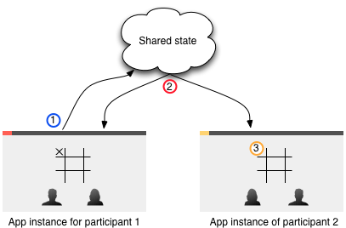
Multiplayer Tic-Tac-Toe Game
Notes:
The data copy to the clients, then they can see the same state

Slide 20
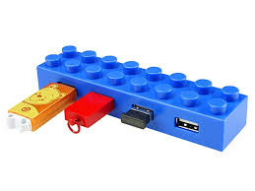
2. Object Interface (API) View
Type-specific interface
Modularity 模块化 in the distributed systems.
Separate interface from implementation. E.g In Remote Procedure Call (RPC) world, client stub calls remote server via virtual interface/function
Notes:
Google doc sheet, type of interface: user interface

Slide 21

3. Integration Protocol View 集成协议视图
Data movement vs. function invocation 调用 between components.
Synchronous vs. Asynchronous communication.
Communication style, syntax, semantics, and timing of protocol makes a huge impact in scaling.
Notes:
function invocation : How to move data efficiently and securely
Handle business operations through api: (two types of business operation)1. long live transaction (shopping， add to shopping cart, 等一会再购买，或签租房合约，很多steps, 没有一次头填完） long live transaction is bounded by batch批量
2. short live transaction,(1-2 mins)
Synchronous同步 api : if you start a transaction, your client has to wait until you get response, complete the transaction
ex : go to bank , withdraw the money,
Asynchronous异步: you can send your request from a client to a server in one transaction,
Communication style:we want it more resiliency抗压， we just have to worry about one way
syntax: what types of payload is going to use(json, protobuf)
semantics:语义学 what does api look like? Api handshake? where the error code? How many endpoint?
timing: how often do u need to call the client, or receive respond from the server

Slide 22

Integration Protocols

Slide 23
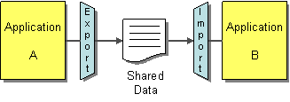
1. File Transfer (FTP)
Notes:
It is reliable and scalable（可扩展的）：the amount of connection that server can handle is significantly high than any other type of protocol.
there is no processing involved, there is no running a query and database, no calculations

Slide 24
1. File Transfer (FTP)
App A writes to a file, then uploads to a FTP server.
App B later downloads and reads the file.
Applications can exchange bulk load散装 of data using FTP.
Apps need to agree on:
Location - ftp://server.com/path/
Filename - order.xml
Format – XML, JSON, CSV, etc…
Timing – when it will be written and read.
FTP makes applications well decoupled but at the cost of timeliness.
Notes:
Time out : 超时
File transfer will time out ( if anything has to happen in one second, or one minutes in two system, (Send data and all other system have to be synchronoized同步） that is not going to happen.

Slide 25
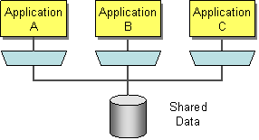
2. Shared Database
Notes:
Limitation:1. single point of failure. if one db goes down, all the dbs go down.
2. load issue( if application a has million of users, b and c have not much users)
if we do database transactions, we can do the locking 1, lock all the entire db, or lock the role

Slide 26
2. Shared Database
Multiple applications share the same DB schema, located in a single physical DB.
Single source of truth—no duplicate data storage.
No data has to be transferred from one app to the other.
Requires unified schema that can meet the needs of multiple applications—a very difficult exercise.
Critical application is likely to suffer delays in order to work with the unified schema.
Frequently READ and WRITE the same data (tables) can turn the DB into a performance bottleneck and can cause deadlocks.

Slide 27
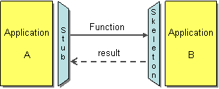
3. Remote Procedure Call (RPC)
Notes:
Integration Protocol View ：Data movement vs. function invocation 调用 between components.

Slide 28
3. Remote Procedure Call (RPC)
One application exposes some of its functionality via API so that other applications can access remotely as a remote procedure.
The communication occurs in real time and synchronously.
Applications can provide multiple interfaces to the same data/functionality.
Examples: CORBA, COM, RMI, .NET Remoting, SOAP-based Web Services, RESTful Web Services, and gRPC.
Notes:
缺点:latency

Slide 29
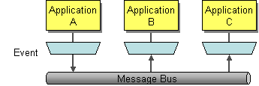
4. Messaging
Notes:
1:30:48
Kafka是由Apache软件基金会开发的一个开源流处理平台，由Scala和Java编写。该项目的目标是为处理实时数据提供一个统一、高吞吐、低延迟的平台。

Slide 30
4. Messaging
One application publishes a message to a common message channel.
Other applications can read the message from the channel.
Applications need to agree on:
Channel/topic/destination
message format
Communication is asynchronous.

Slide 31

Communication Styles

Slide 32
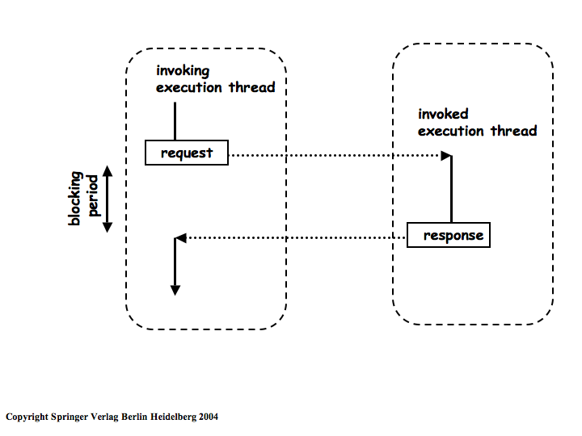
I. Synchronous/Blocking Calls
Notes:
The client pay for the money , and wait for the response
90% api is blocking calls
Two dotted line is the latency
Response time : latency + processing time

Slide 33
I. Synchronous/Blocking Calls
Traditional systems use blocking calls—client waits while server is processing request.
Synchronous interaction requires both parties to be “on-line”
Advantages: simplicity, easy to understand and debug, client thread’s state doesn’t change while waiting
Disadvantages: connection overhead, waiting is the major concern for performance, higher probability of failures as the load increases.

Slide 34
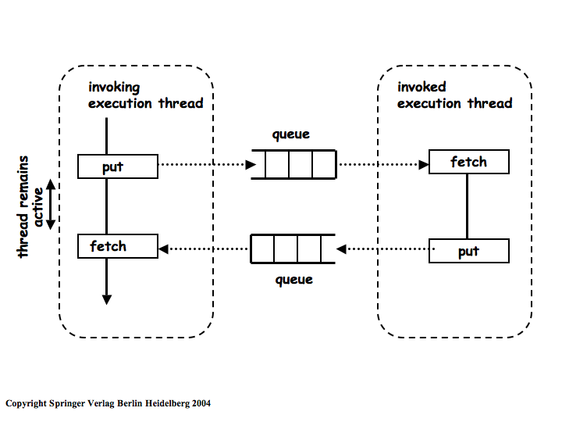
II. Asynchronous/Non-Blocking Calls
Messaging protocol
The response queue can come in a different order
Notes:
Higher latency than synchronous , you have more network to go through, it is not good for real time processing
Processing time is the same for asynchronous and synchronous, the latency is different
Response time: typically asynchronous will be higher than synchronous

Slide 35
II. Asynchronous/Non-Blocking Calls
With non-blocking calls, a call to the server returns immediately.
Client can continue to run and occasionally check with server to see if a response is ready.
Eliminates the need for any coordination between parties.
Advantages: more modular, reduce problems with connection management, no real-time dependency between components, and fault tolerance.
Disadvantages: adds complexity to client architecture, requires messages to be stored at some intermediate place until they are consumed by the receiver.

